Slide 1
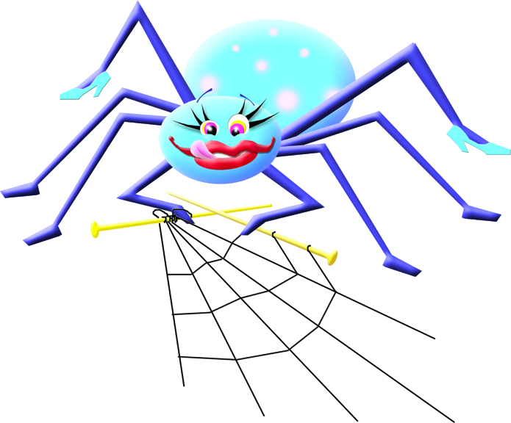
Nancy
The lazy web site builder
Reuben Thomas

Slide 2
Why?
Impatient user
  Existing hand-written web site getting too big
  No time to learn complex tools
Lazy author
  No money to motivate me!
  I already had the code in another project
Result: hubris
  User has no time to learn a new system, I have no time to write one; result:

Slide 3
What?
$include{file}
  a one-feature template system
  cut out of Wiklet, my tiny wiki
  fragments are written from template tree and pages are written to HTML page tree
Problem: what about specialisation for different pages?
Answer: inheritance

Slide 4


What??
Think “specialization” not “inheritance”
root
hb
template
index
people
navbar
body
navbar
nayase
body

Slide 5
Result
root
index
people
nayase

Slide 6
Nice, but isn't it just a toy?
Already used for a corporate web site of about 100 pages, assembled from over 400 fragments: http://www.adsensus.net/
Currently being used to develop a web site of roughly double that complexity
Can handle just about anything without dynamically computed content
  Put another way, if the content is all static, the logical structure should mirror the site structure

Slide 7
Moral
The 80/20 rule sets the bar too high:
start with 50/1, and assume YAGNI
  Nancy is ~50 LOC
Never underestimate how simply you can solve a problem

Slide 8
More questions
Where? http://rrt.sc3d.org/Software/Nancy
How? GPL
Even more questions?

